Slide 1
CS326 Parallel and Distributed Computing
Fall 2021
National University of Computer and Emerging Sciences

Slide 2
Parallel Computer Memory Architectures

Slide 3
Memory architectures
Shared Memory
Distributed Memory
Hybrid Distributed-Shared Memory

Slide 4
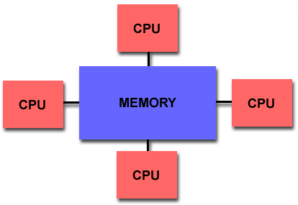
Shared Memory
Shared memory parallel computers vary widely, but generally have in common the ability for all processors to access all memory as global address space.
Multiple processors can operate independently but share the same memory resources.
Changes in a memory location effected by one processor are visible to all other processors.
Shared memory machines can be divided into two main classes based upon memory access times: UMA and NUMA.

Slide 5
Shared Memory : UMA vs. NUMA
Uniform Memory Access (UMA):
Most commonly represented today by Symmetric Multiprocessor (SMP) machines
Identical processors with equal access and access times to memory
Sometimes called CC-UMA - Cache Coherent UMA.
Non-Uniform Memory Access (NUMA):
Often made by physically linking two or more SMPs
One SMP can directly access memory of another SMP
Not all processors have equal access time to all memories
Notes:
Cache coherent means if one processor updates a location in shared memory, all the other processors know about the update. Cache coherency is accomplished at the hardware level.

Slide 6
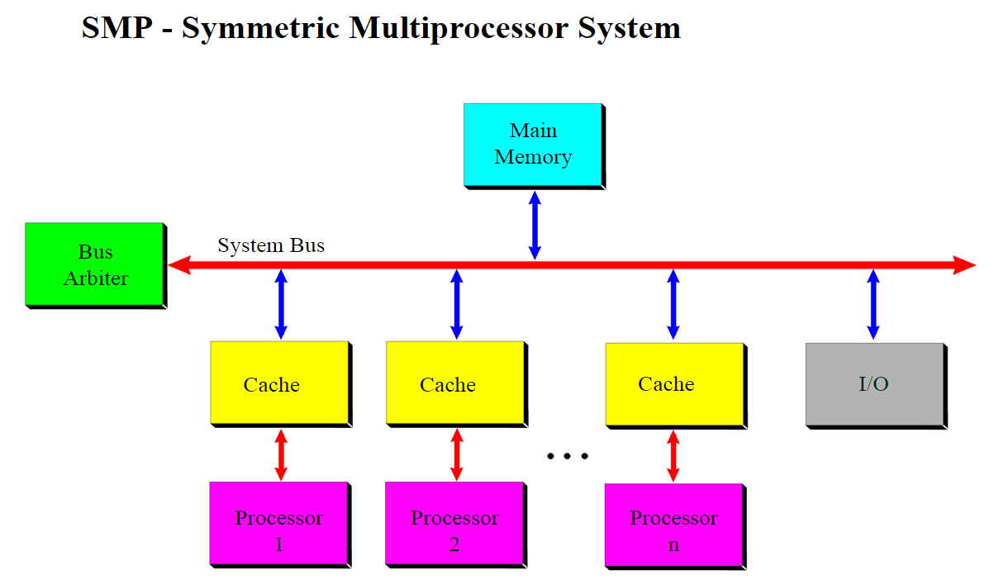

Slide 7
Shared Memory: Pro and Con
Advantages
Global address space provides a user-friendly programming perspective to memory
Data sharing between tasks is both fast and uniform due to the proximity of memory to CPUs
Disadvantages:
Primary disadvantage is the lack of scalability between memory and CPUs. Adding more CPUs can geometrically increases traffic on the shared memory-CPU path, and for cache coherent systems, geometrically increase traffic associated with cache/memory management.
Programmer responsibility for synchronization constructs that insure "correct" access of global memory.
Expense: it becomes increasingly difficult and expensive to design and produce shared memory machines with ever increasing numbers of processors.

Slide 8
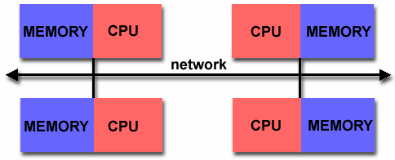
Distributed Memory
Like shared memory systems, distributed memory systems vary widely but share a common characteristic. Distributed memory systems require a communication network to connect inter-processor memory.
Processors have their own local memory. Memory addresses in one processor do not map to another processor, so there is no concept of global address space across all processors.
Because each processor has its own local memory, it operates independently. Changes it makes to its local memory have no effect on the memory of other processors. Hence, the concept of cache coherency does not apply.
When a processor needs access to data in another processor, it is usually the task of the programmer to explicitly define how and when data is communicated. Synchronization between tasks is likewise the programmer's responsibility.
The network "fabric" used for data transfer varies widely, though it can can be as simple as Ethernet.

Slide 9
Distributed Memory: Pro and Con
Advantages
Memory is scalable with number of processors. Increase the number of processors and the size of memory increases proportionately.
Each processor can rapidly access its own memory without interference and without the overhead incurred with trying to maintain cache coherency.
Cost effectiveness: can use commodity, off-the-shelf processors and networking.
Disadvantages
The programmer is responsible for many of the details associated with data communication between processors.
It may be difficult to map existing data structures, based on global memory, to this memory organization.
Non-uniform memory access (NUMA) times

Slide 10
Hybrid Distributed-Shared Memory
Comparison of Shared and Distributed Memory Architectures
Architecture | CC-UMA | CC-NUMA | Distributed
Examples | SMPs Sun Vexx DEC/Compaq SGI Challenge IBM POWER3 | Bull NovaScale SGI Origin Sequent HP Exemplar DEC/Compaq IBM POWER4 (MCM) | Cray T3E Maspar IBM SP2 IBM BlueGene
Communications | MPI Threads OpenMP shmem | MPI Threads OpenMP shmem | MPI
Scalability | to 10s of processors | to 100s of processors | to 1000s of processors
Draw Backs | Memory-CPU bandwidth | Memory-CPU bandwidth Non-uniform access times | System administration Programming is hard to develop and maintain
Software Availability | many 1000s ISVs | many 1000s ISVs | 100s ISVs

Slide 11
Chapter2: Parallel Computing Platforms

Slide 12
Implicit Parallelism: Trends in Microprocessor Architectures
Traditionally a sequential computer consists of:
processor, memory, and datapath
all present bottleneck to the performance
Increments in clock speed are severely diluted by the limitations of memory technology

Slide 13
Pipelining and Superscalar Execution
Pipelining: overlapping various stages in instruction execution
fetch, schedule, decode, operand fetch, execute, store, among others
Pentium 4, which operates at 2.0 GHz, has a 20 stage pipeline.
Speed of a single pipeline is ultimately limited by the largest atomic task in the pipeline.
In typical instruction traces, every fifth to sixth instruction is a branch instruction.
This requires need effective techniques for predicting branch destinations so that pipelines can be speculatively filled, a mis-prediction will cost a lot.
Use multiple pipelines. The ability of a processor to issue multiple instructions in the same cycle is referred to as superscalar execution
During each clock cycle, multiple instructions are piped into the processor in parallel.
These instructions are executed on multiple functional units.

Slide 14
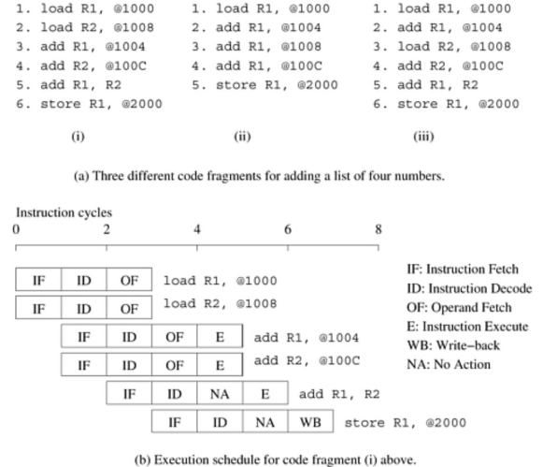

Slide 15
A number of issues needs to be resolved with superscalar execution
Data Dependency
Resource Dependency
Branch/Procedural Dependency
The processor needs the ability to issue instructions out-of-order to accomplish desired reordering.
The parallelism available in in-order issue of instructions can be highly limited.
Most current microprocessors are capable of out-of-order issue and completion.
This model, also referred to as dynamic instruction issue, exploits maximum instruction level parallelism.

Slide 16
Very Long Instruction Word (VLIW) Processors
The parallelism extracted by superscalar processors is often limited by the instruction look-ahead.
Instructions that can be executed concurrently are packed into groups and parceled off to the processor as a single long instruction word to be executed on multiple functional units at the same time.
The compiler has a larger context from which to select instructions
The performance of VLIW processors is very sensitive to the compilers‘ ability to detect data and resource dependencies and read and write hazards, and to schedule instructions for maximum parallelism.

Slide 17
Limitation of Memory System Performance
The effective performance of a program on a computer relies not just on the speed of the processor but also on the ability of the memory system to feed data to the processor.
Latency: request to receiving time for a memory word.
Rate at which data can be pumped from the memory to the processor determines the bandwidth of the memory system.

Slide 18
Example
a processor operating at 1 GHz (1 ns clock) connected to a DRAM with a latency of 100 ns (no caches)
The processor is capable of executing four instructions in each cycle of 1 ns (4 GFLOPS).
Since the memory latency is equal to 100 cycles and block size is one word, every time a memory request is made, the processor must wait 100 cycles before it can process the data

Slide 19
Improving Effective Memory Latency Using Caches
Cache: a low-latency high-bandwidth storage between the processor and the DRAM.
The data needed by the processor is first fetched into the cache. All subsequent accesses to data items residing in the cache are serviced by the cache.
Thus, in principle, if a piece of data is repeatedly used, the effective latency of this memory system can be reduced by the cache.
The fraction of data references satisfied by the cache is called the cache hit ratio of the computation on the system.
Data reuse is critical for cache performance because if each data item is used only once, it would still have to be fetched once per use from the DRAM

Slide 20
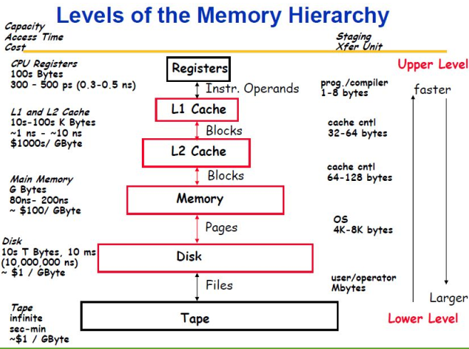

Slide 21
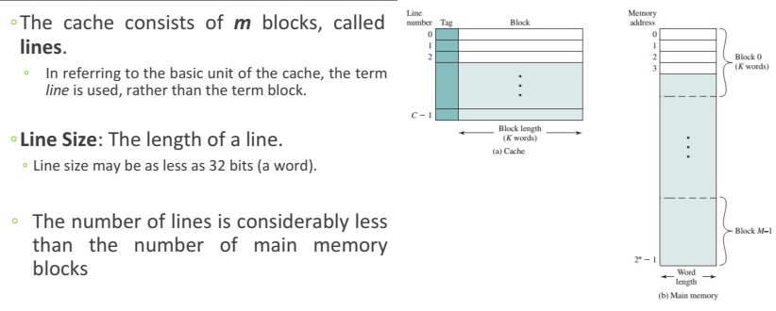

Slide 22
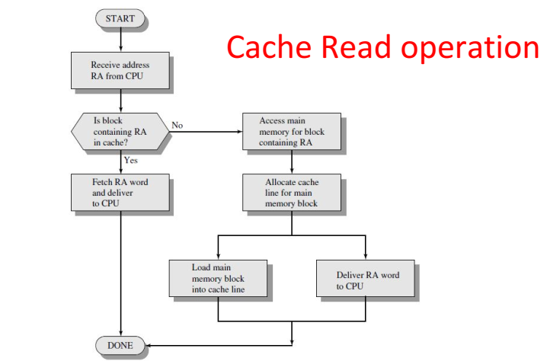

Slide 23
Impact of Memory Bandwidth
One commonly used technique to improve memory bandwidth is to increase the size of the memory blocks.
Consider again a memory system with a single cycle cache and 100 cycle latency DRAM with the processor operating at 1 GHz
If the block size is one word, the processor takes 100 cycles to fetch each word.
If the block size is increased to four words, i.e., the processor can fetch a four-word cache line every 100 cycles.
increasing the block size from one to four words did not change the latency of the memory system. However, it increased the bandwidth four-fold.

Slide 24
Another way of quickly estimating performance bounds is to estimate the cache hit ratio.
Temporal and Spatial Locality of Data:
Temporal locality refers to the reuse of specific data, and/or resources, within a relatively small time duration.
Spatial locality (also termed data locality) refers to the use of data elements within relatively close storage locations. Sequential locality.
a special case of spatial locality, occurs when data elements are arranged and accessed linearly, such as, traversing the elements in a one-dimensional array.

Slide 25
Cache Coherence
The presence of caches on processors also raises the issue of multiple copies of a single memory word being manipulated by two or more processors at the same time
Cache coherence is intended to manage such conflicts by maintaining a coherent view of the data values in multiple caches

Slide 26
Cache Coherence (Cont’d)
Write Propagation
Changes to the data in any cache must be propagated to other copies (of that cache line) in the peer caches
Transaction Serialization
Reads/Writes to a single memory location must be seen by all processors in the same order.

Slide 27
Alternate Approaches for Hiding Memory Latency
Imagine sitting at your computer browsing the web during peak network traffic hours.
The lack of response from your browser can be alleviated using one of three simple approaches:
Anticipate which pages we are going to browse ahead of time and issue requests for them in advance: Prefetching
we open multiple browsers and access different pages in each browser, thus while we are waiting for one page to load, we could be reading others: multi-threading
we access a whole bunch of pages in one go – remunerating the latency across various accesses: Spatial Locality

Slide 28
Prefetching for Latency Hiding
Prefetching is a technique used by computer processors to boost execution performance by fetching instructions or data from their original storage in slower memory to a faster local memory before it is actually needed (hence the term 'prefetch')
In a typical program, a data item is loaded and used by a processor in a small time window. If the load results in a cache miss, then the use stalls.
A simple solution to this problem is to advance the load operation so that even if there is a cache miss, the data is likely to have arrived by the time it is used.
However, if the data item has been overwritten between load and use, a fresh load is issued.

Slide 29
Multithreading for Latency Hiding
If a thread gets a lot of cache misses, the other threads can continue taking advantage of the unused computing resources, which may lead to faster overall execution, as these resources would have been idle if only a single thread were executed.
Also, if a thread cannot use all the computing resources of the CPU (because instructions depend on each other's result), running another thread may prevent those resources from becoming idle.
Notes:
Task 2: Elaborate with example, where a problem would have been better solved with multithreading.

Slide 30
Multithreading for Latency Hiding
Multiple threads, however can interfere with each other when sharing hardware resources such as caches.
As a result, execution times of a single thread are not improved and can be degraded, even when only one thread is executing, due to lower frequencies or additional pipeline stages that are necessary to accommodate thread-switching hardware.
Notes:
Task 2: Elaborate with example, where a problem would have been better solved with multithreading.

Slide 31

Multithreading for Latency Hiding
Because each dot-product is independent of the other, and therefore represents a concurrent unit of execution, we may rewrite the above code as:

Slide 32
Multithreaded processors are capable of maintaining the context of a number of threads of computation with outstanding requests (memory accesses, I/O, or communication requests) and execute them as the requests are satisfied.
Machines such relying on multithreaded processors that can switch the context of execution in every cycle .
they are able to hide latency effectively, provided there is enough concurrency (threads) to keep the processor from idling.

Slide 33

2.3 Dichotomy of Parallel Computing Platforms
Control Structure of Parallel Platforms
Parallel tasks can be specified at various levels of granularity.
At one extreme, each program in a set of programs can be viewed as one parallel task.
At the other extreme, individual instructions within a program can be viewed as parallel tasks.
E.g. Parallelism for single instruction:
Notes:
In this example, various iterations of the loop are independent of each other; i.e., c[0] = a[0] + b[0]; c[1] = a[1] + b[1];, etc., can all be executed independently of each other. Consequently, if there is a mechanism for executing the same instruction, in this case add on all the processors with appropriate data, we could execute this loop much faster.

Slide 34
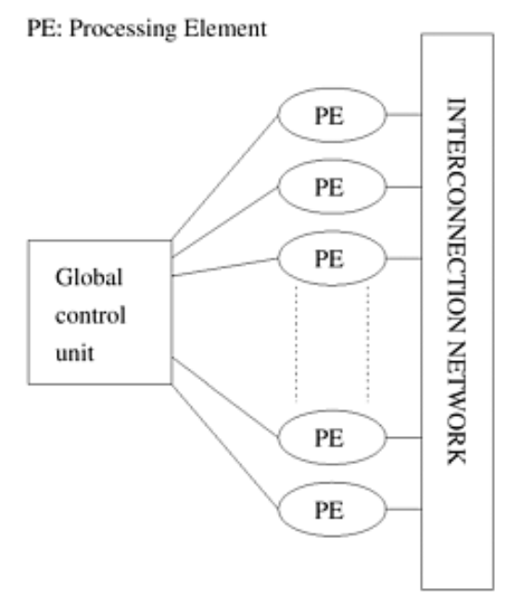
Processing units in parallel computers either operate under the centralized control of a single control unit or work independently.
In SIMD, a single control unit dispatches instructions to each processing unit.
In an SIMD parallel computer, the same instruction is executed synchronously by all processing units.
While the SIMD concept works well for structured computations on parallel data structures such as arrays, often it is necessary to selectively turn off operations on certain data items, this may limit the utilization of processing elements.

Slide 35
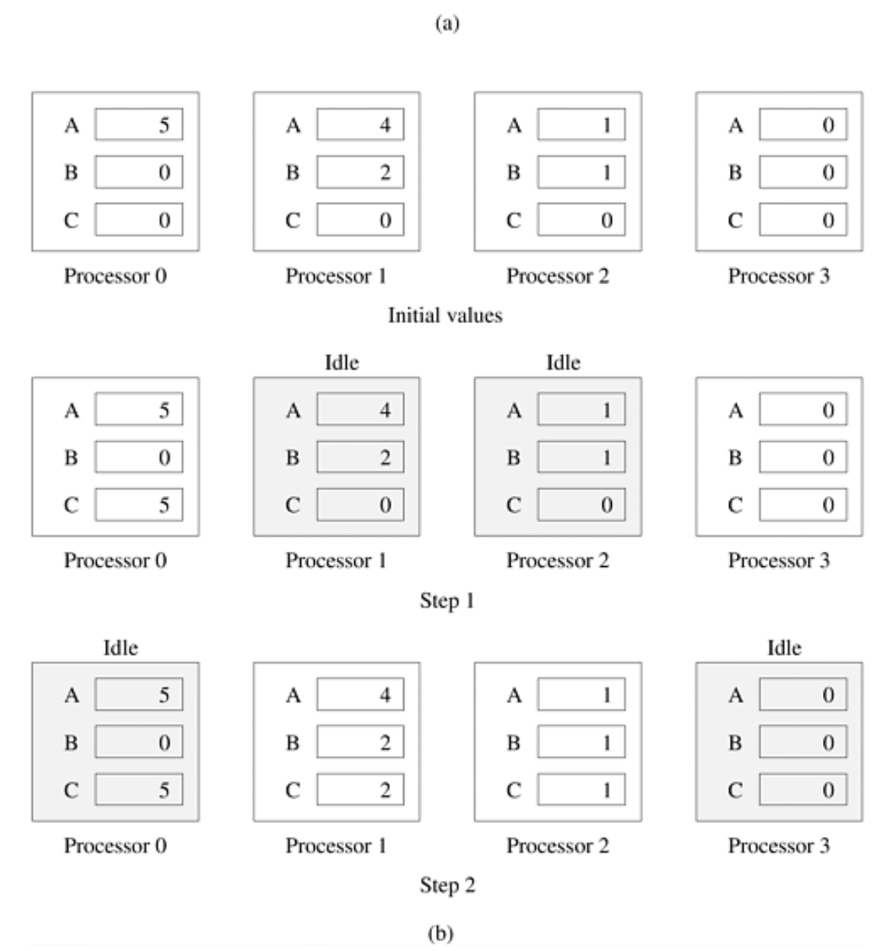
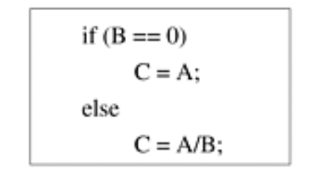

Slide 36
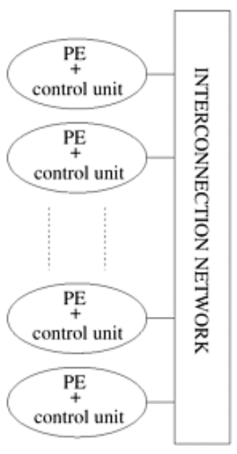
In contrast to SIMD architectures, MIMD are the computers in which each processing element is capable of executing a different program independent of the other processing elements.
SIMD : less hardware than MIMD computers because they have only one global control unit, and less memory because only one copy of the program needs to be stored
Notes:
Multiple instruction stream, multiple data stream

Slide 37
Communication Model of Parallel Platforms
There are two primary forms of data exchange between parallel tasks:
Shared-Address-Space Platforms
Message-Passing Platforms

Slide 38
Shared-Address-Space Platforms
common data space is accessible to all processors .
If the time taken by a processor to access any memory word in the system (global or local) is identical, the platform is classified as a uniform memory access (UMA) multicomputer.
On the other hand, if the time taken to access certain memory words is longer than others, the platform is called a non-uniform memory access (NUMA) multicomputer
The presence of a global memory space makes programming such platforms much easier.
All read-only interactions are invisible to the programmer, as they are coded no differently than in a serial program. This greatly eases the burden of writing parallel programs. Read/write interactions are, however, harder to program than the read-only interactions, as these operations require mutual exclusion for concurrent accesses
Notes:
we define NUMA and UMA architectures only in terms of memory access times and not cache access times.

Slide 39
The presence of caches on processors also raises the issue of multiple copies of a single memory word being manipulated by two or more processors at the same time.
Supporting a shared address-space in this context involves two major tasks:
providing an address translation mechanism that locates a memory word in the system,
ensuring that concurrent operations on multiple copies of the same memory word have well-defined semantics. Cache coherence mechanism.
Notes:
In computer architecture, cache coherence is the uniformity of shared resource data that ends up stored in multiple local caches. When clients in a system maintain caches of a common memory resource, problems may arise with incoherent data, which is particularly the case with CPUs in a multiprocessing system.

Slide 40
Message-Passing Platforms
Logically, a message-passing platform consists of p processing nodes, each with its own exclusive address space.
Interactions between processes running on different nodes must be accomplished using messages (data, work, and to synchronize actions among the processes), hence the name message passing.
The basic operations in this programming paradigm are send and receive

Slide 41
Physical Organization of Parallel Platforms
Parallel random access machine (PRAM):
Processors share a common clock but may execute different instructions in each cycle.
PRAMs allow concurrent access to various memory locations, depending on how simultaneous memory accesses are handled.
Exclusive-read, exclusive-write (EREW) PRAM. In this class, access to a memory location is exclusive. No concurrent read or write operations are allowed
Concurrent-read, exclusive-write (CREW) PRAM. multiple read accesses to a memory location are allowed. write accesses to a memory location are serialized.
Exclusive-read, concurrent-write (ERCW) PRAM
Concurrent-read, concurrent-write (CRCW) PRAM

Slide 42
Concurrent write access to a memory location requires settlement. Several protocols are used to resolve concurrent writes.
Common, in which the concurrent write is allowed if all the values that the processors are attempting to write are identical.
Arbitrary, in which an arbitrary processor is allowed to proceed with the write operation and the rest fail.
Priority, in which all processors are organized into a predefined prioritized list, and the processor with the highest priority succeeds and the rest fail.
Sum, in which the sum of all the quantities is written (the sum-based write conflict resolution model can be extended to any associative operator defined on the quantities being written

Slide 43
Interconnection Networks for Parallel Computers
Interconnection networks provide mechanisms for data transfer between processing nodes or between processors and memory modules.
The interconnect plays a decisive role in the performance of both distributed and shared-memory systems: even if the processors and memory have virtually unlimited performance, a slow interconnect will seriously degrade the overall performance.
Typical interconnection networks are built using links and switches.
A link corresponds to physical media such as a set of wires or fibers capable of carrying information.

Slide 44
Interconnection Networks for Parallel Computers
Static Interconnection Networks consist of point-to-point communication links among processing nodes and are also referred to as direct networks.
Dynamic Interconnection Networks, on the other hand, are built using switches and communication links. Communication links are connected to one another dynamically by the switches. Dynamic networks are also referred to as indirect networks.
A single switch in an interconnection network consists of a set of input ports and a set of output ports. The total number of ports on a switch is also called the degree of the switch.
Switches may also provide support for internal buffering (when the requested output port is busy), routing (to alleviate congestion on the network), and multicast (same output on multiple ports)

Slide 45
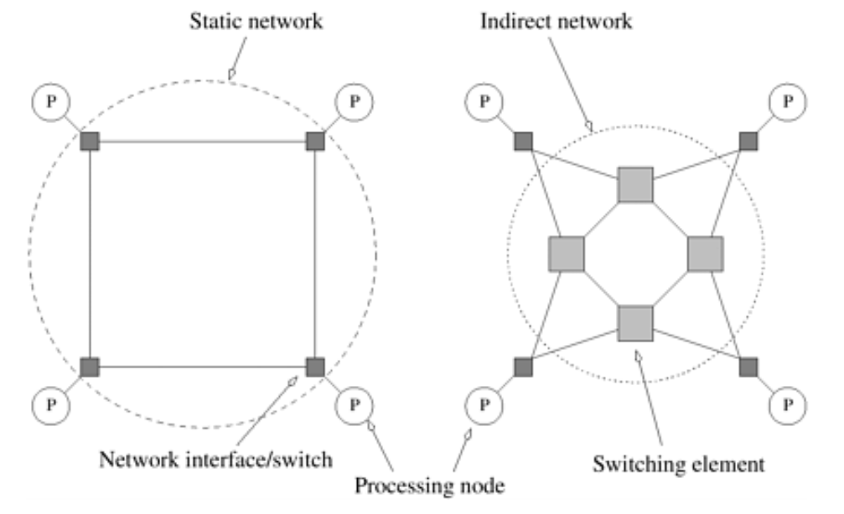

Slide 46
Network Topologies
Bus-Based Networks
A bus-based network is perhaps the simplest network consisting of a shared medium that is common to all the nodes.
since the communication wires are shared, as the number of devices connected to the bus increases, the likelihood that there will be contention for use of the bus increases.
Notes:
A bus is a collection of parallel communication wires together with some hardware that controls access to the bus.

Slide 47
The distance between any two nodes in the network is constant.
Buses are also ideal for broadcasting information among nodes.
Since the transmission medium is shared, there is little overhead associated with broadcast compared to point-to-point message transfer.
The bounded bandwidth of a bus places limitations on the overall performance of the network as the number of nodes increases. Typical bus based machines are limited to dozens of nodes.
The demands on bus bandwidth can be reduced by making use of the property that in typical programs, a majority of the data accessed is local to the node. For such programs, it is possible to provide a cache for each node. Private data is cached at the node and only remote data is accessed through the bus.

Slide 48
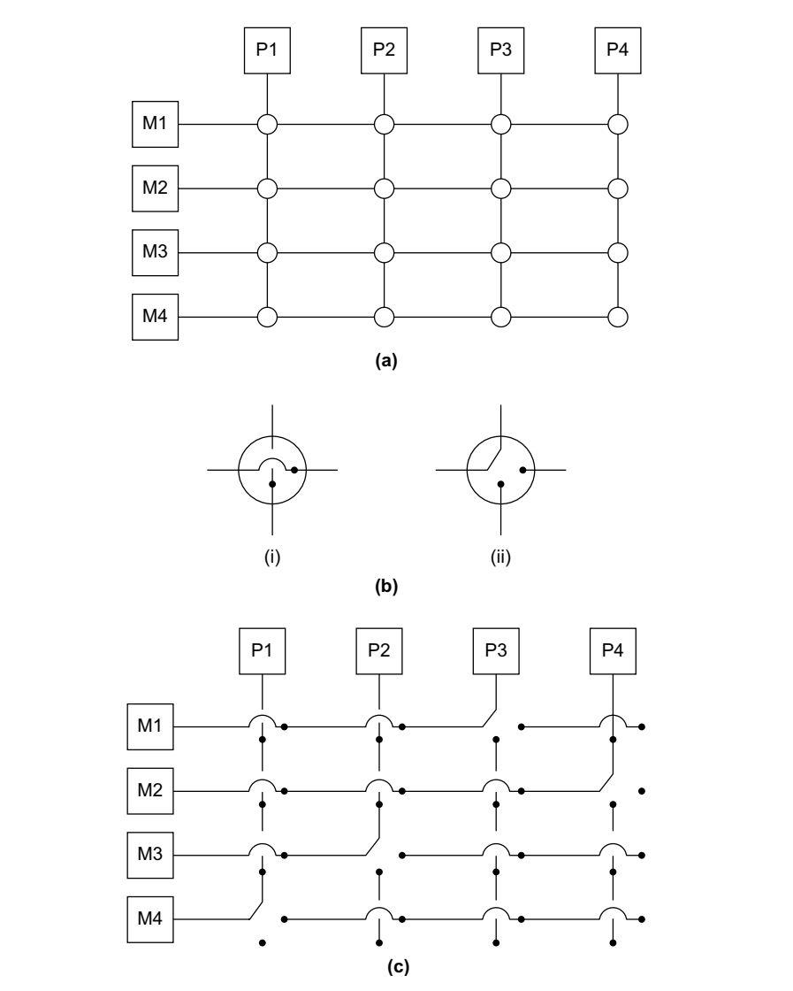

A Crossbar Network
Notes:
The crossbar network is a non-blocking network in the sense that the connection of a processing node to a memory bank does not block the connection of any other processing nodes to other memory banks. (b) A switching element.

Slide 49
The crossbar interconnection network is scalable in terms of performance but unscalable in terms of cost.
Conversely, the shared bus network is scalable in terms of cost but unscalable in terms of performance.
An intermediate class of networks called multistage interconnection networks lies between these two extremes

Slide 50
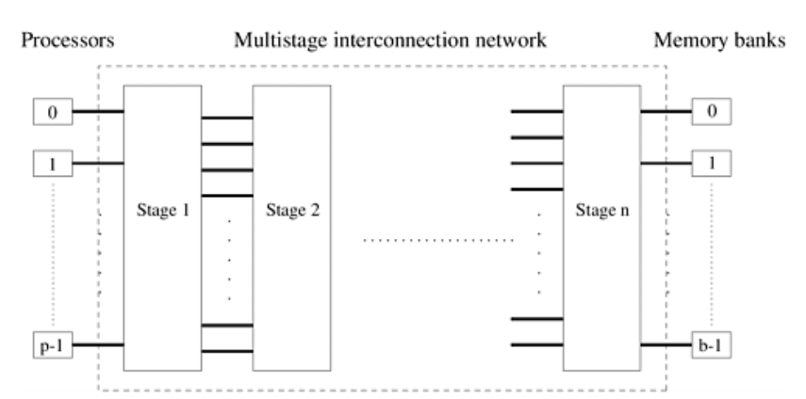

Slide 51
OMEGA Network
An 8x8 Omega network is a multistage interconnection network, meaning that processing elements (PEs) are connected using multiple stages of switches.
The outputs from each stage are connected to the inputs of the next stage using a perfect shuffle connection system.
This network consists of log p stages, where p is the number of inputs (processing nodes) and also the number of outputs (memory banks).
In terms of binary representation of the PEs, each stage of the perfect shuffle can be thought of as a cyclic logical left shift each bit in the address is shifted once to the left, with the most significant bit moving to the least significant bit.

Slide 52
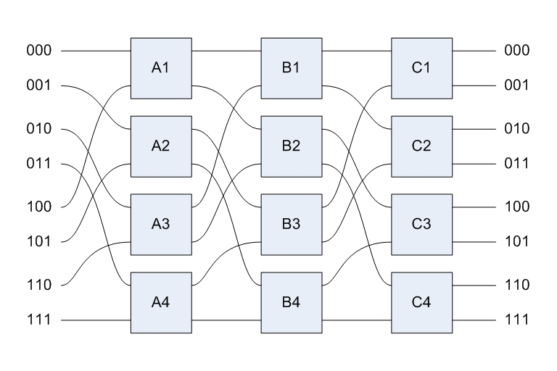
At each stage, adjacent pairs of inputs are connected to a simple exchange element, which can be set either straight (pass inputs directly through to outputs) or crossed (send top input to bottom output, and vice versa)

Slide 53
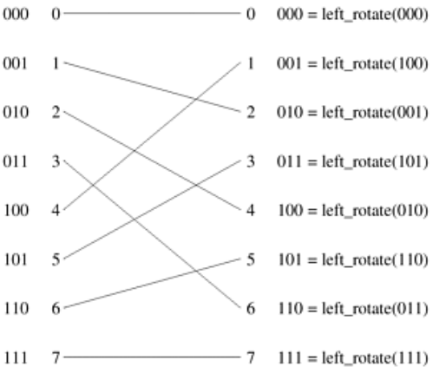
Each switch is in one of two connection modes. In one mode, the inputs are sent straight through to the outputs, this is called the pass-through connection.
In the other mode, the inputs to the switching node are crossed over and then sent out, which is called the cross-over connection.

Slide 54
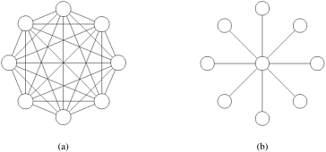
Completely-Connected Network
In a completely-connected network, (MESH), each node has a direct communication link to every other node in the network.
The communication between any input/output pair does not block communication between any other pair.
Due to the large number of links in completely connected networks, sparser networks are typically used to build parallel computers

Slide 55

Linear Arrays, Meshes, and k-d Meshes
A linear array is a static network in which each node (except the two nodes at the ends) has two neighbors, one each to its left and right.
A simple extension of the linear array is the ring or a 1-D torus.
The ring has a wraparound connection between the extremities of the linear array. In this case, each node has two neighbors

Slide 56
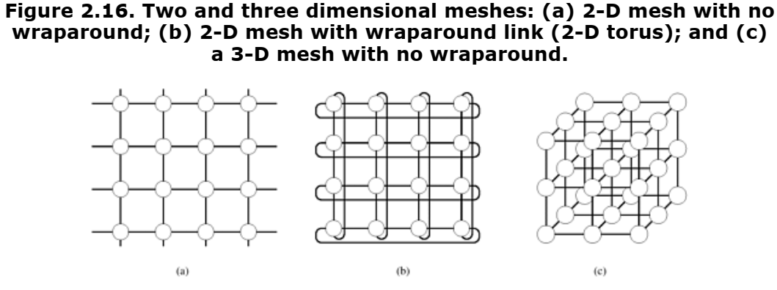

Slide 57
Star Connected Network
In a star-connected network, one processor acts as the central processor. Every other processor has a communication link connecting it to this processor.
The central processor is the bottleneck in the star topology

Slide 58
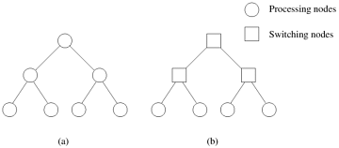
Tree-Based Networks
A tree network is one in which there is only one path between any pair of nodes.
Static tree networks have a processing element at each node of the tree (Figure a)
Tree networks also have a dynamic counterpart. In a dynamic tree network, nodes at intermediate levels are switching nodes and the leaf nodes are processing elements (Figure b)

Slide 59
Tree-Based Networks
To route a message in a tree, the source node sends the message up the tree until it reaches the node at the root of the smallest subtree (the first common parent node) containing both the source and destination nodes.
Then the message is routed down the tree towards the destination node.

Slide 60
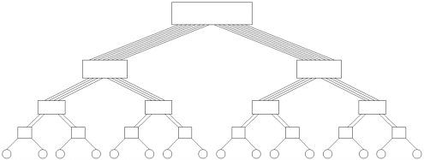
Tree-Based Networks
Tree networks suffer from a communication bottleneck at higher levels of the tree.
This problem can be alleviated in dynamic tree networks by increasing the number of communication links and switching nodes closer to the root. This network, also called a fat tree.

Slide 61
Evaluating Static Interconnection Networks
Diameter
The diameter of a network is the maximum distance between any two processing nodes in the network.
The distance between two processing nodes is defined as the shortest path (in terms of number of links) between them.
The distance between two processing nodes is defined as the shortest path (in terms of number of links) between them.
The diameter of a completely-connected network is one, and that of a star-connected network is two

Slide 62
Connectivity
The connectivity of a network is a measure of the multiplicity of paths between any two processing nodes.
A network with high connectivity is desirable, because it lowers contention for communication resources.
Bisection Width
The bisection width of a network is defined as the minimum number of communication links that must be removed to partition the network into two equal halves.
E.g. Bisection width of TREE and STAR is one, RING is two.

Slide 63
The number of bits that can be communicated simultaneously over a link connecting two nodes is called the channel width.
Channel width is equal to the number of physical wires in each communication link.
The peak rate at which a single physical wire can deliver bits is called the channel rate.
The peak rate at which data can be communicated between the ends of a communication link is called channel bandwidth.
The bisection bandwidth of a network is defined as the minimum volume of communication allowed between any two halves of the network.

Slide 64
Cost
One way of defining the cost of a network is in terms of the number of communication links or the number of wires required by the network.
E.g. Linear arrays and trees use only p - 1 links to connect p nodes

